Slide 1

Course Registration System
JEDI 7 - GROUP 6

Slide 2
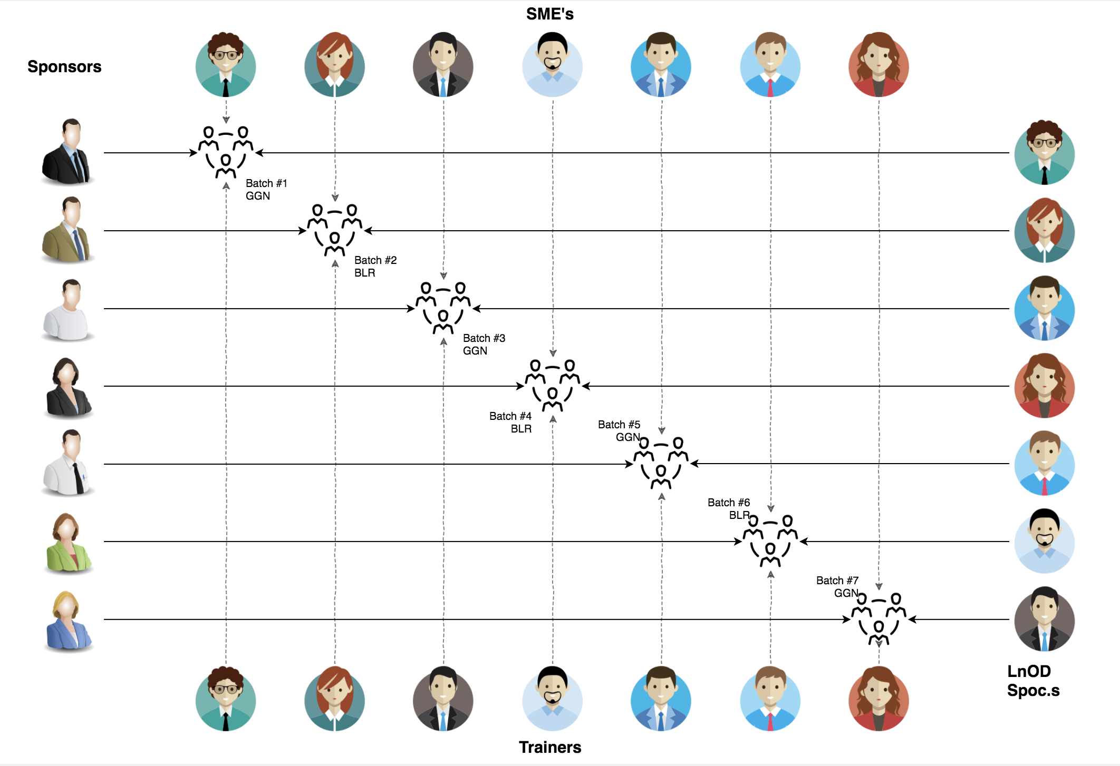
Stakeholders
Sponsors
Flipkart
SME’s
Deepika Gajraj
Sakshi (Order Trainings)
Khushboo Agrawal
3. Trainers
Amit Balyan

Slide 3

Agenda
01
Our Journey
02
Our Team
03
Team Structure
04
Problem Statement
05
Engineering Practices
06
Tech Stack
07
Challenges & Learnings
08
Architecture Design & UML Diagrams
09
Demo
10
Q&A

Slide 4

Our Journey
Notes:
Time - 2 mins

Slide 5
ACTION PLAN
 | Modules | Description
Week 1 (Aug,16 - Aug,22) | UNIX GIT UML Diagrams | Understanding Unix and Git commands Requirement understanding and diagram design
Week 2 (Aug,23 - Aug,29) | Java 8 Exception Handling SQL | Developing a POS Application using Java and MySQL. Understanding Java 8 features and collections
Week 3 (Aug,30 - Aug,31) | Jersey and DropWizard | REST API Development using Jersey and DropWizard framework

Slide 6
Demo
Testing
Process
5
Project Presentation
Tools
4
Testing on Console, REST client such as Postman
Comprehend
3
Architecture Design and Development
2
Decide the Technology stack for console and REST API development
1
Understanding Project Requirements and Goals

Slide 7
Our next starts
NOW
Notes:
Time – 1 min
Swati

Slide 8
2 WEEKS OF TRAINING + PROJECT DEMO
12 DAYS
96 HOURS
5760 MINUTES
345,600 SECONDS
LIMITLESS KNOWLEDGE

Slide 9

Our Team
Notes:
Time – 2 mins

Slide 10
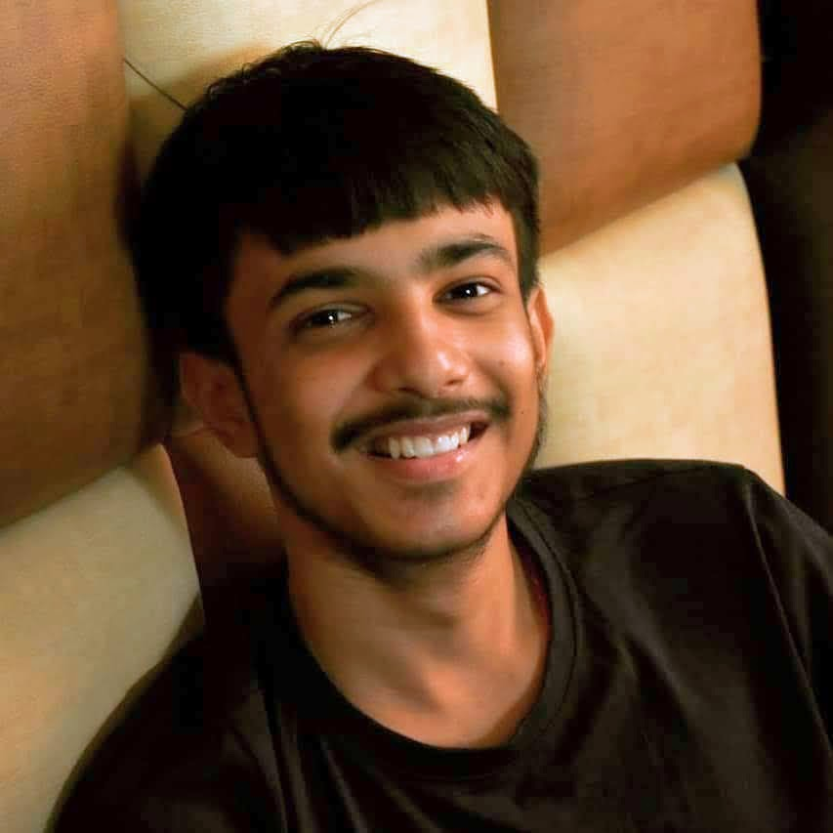
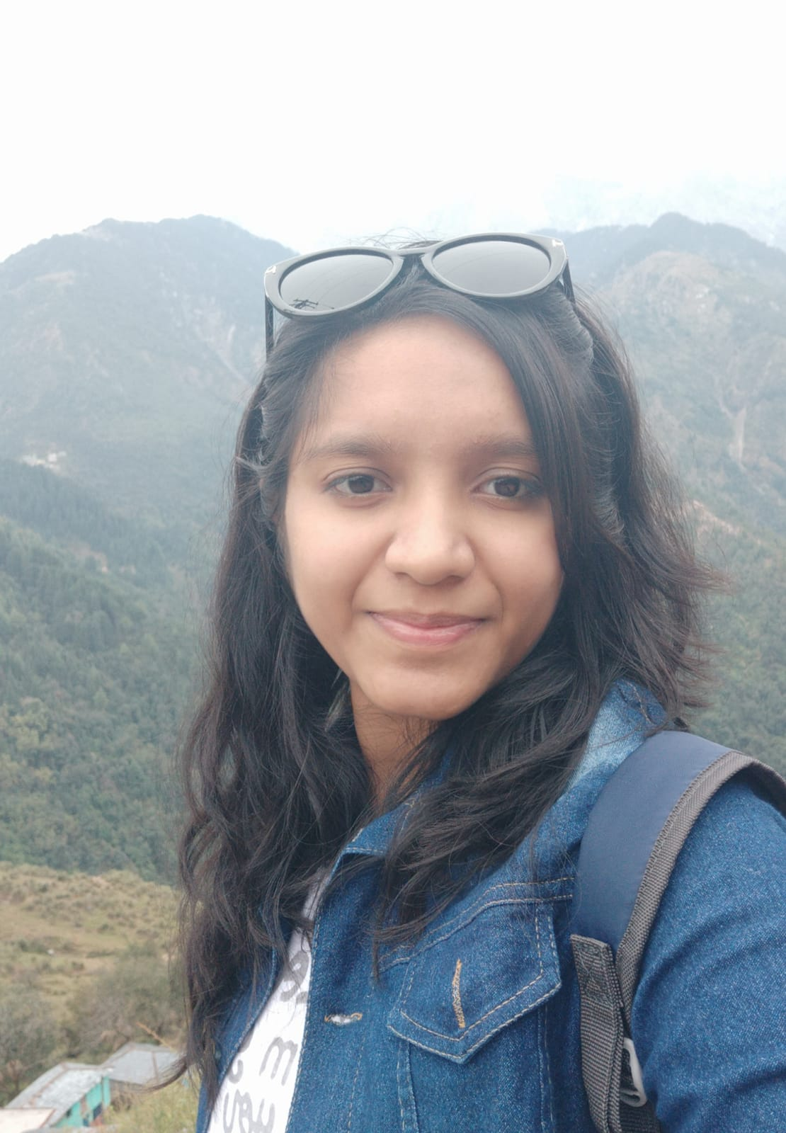
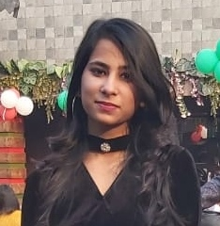
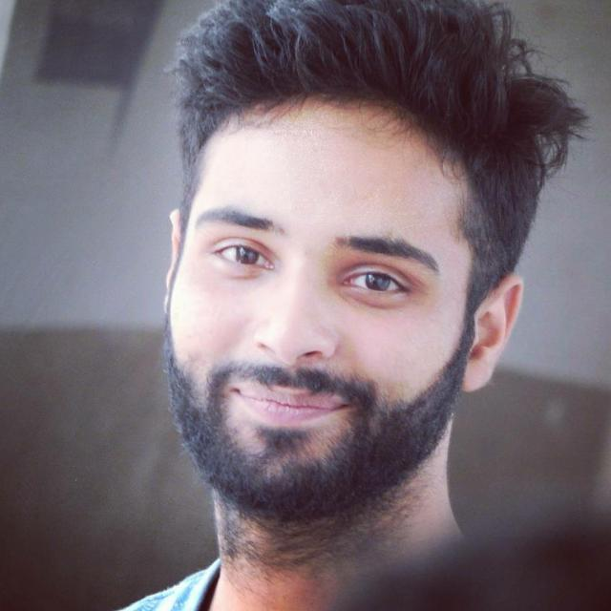
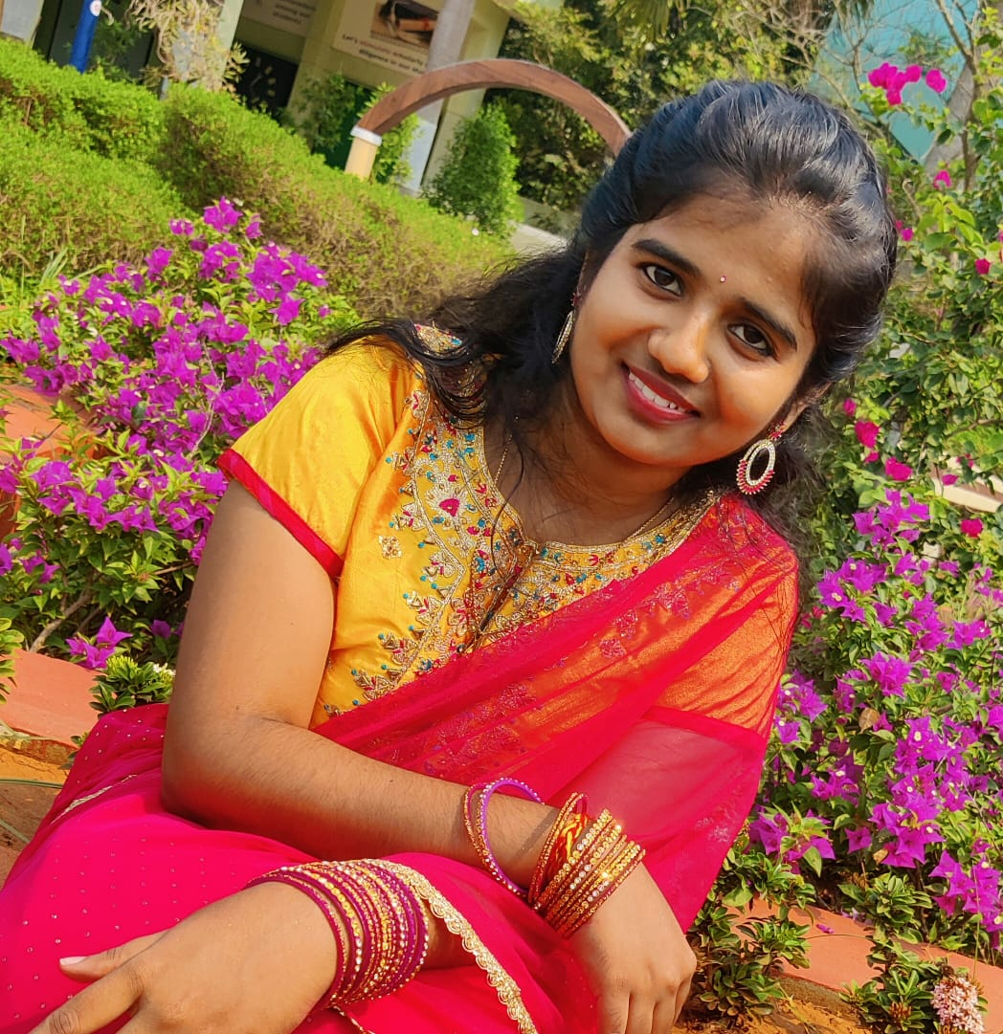
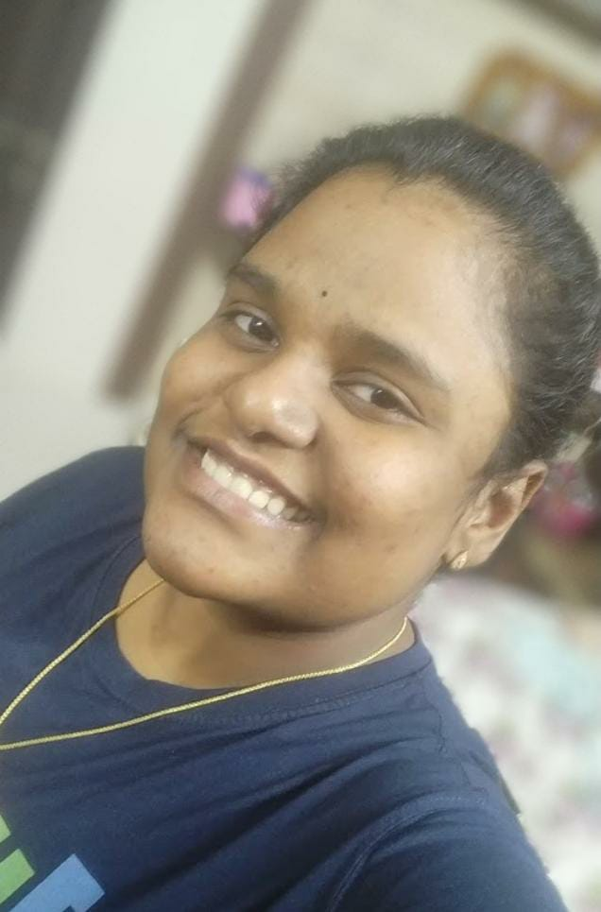
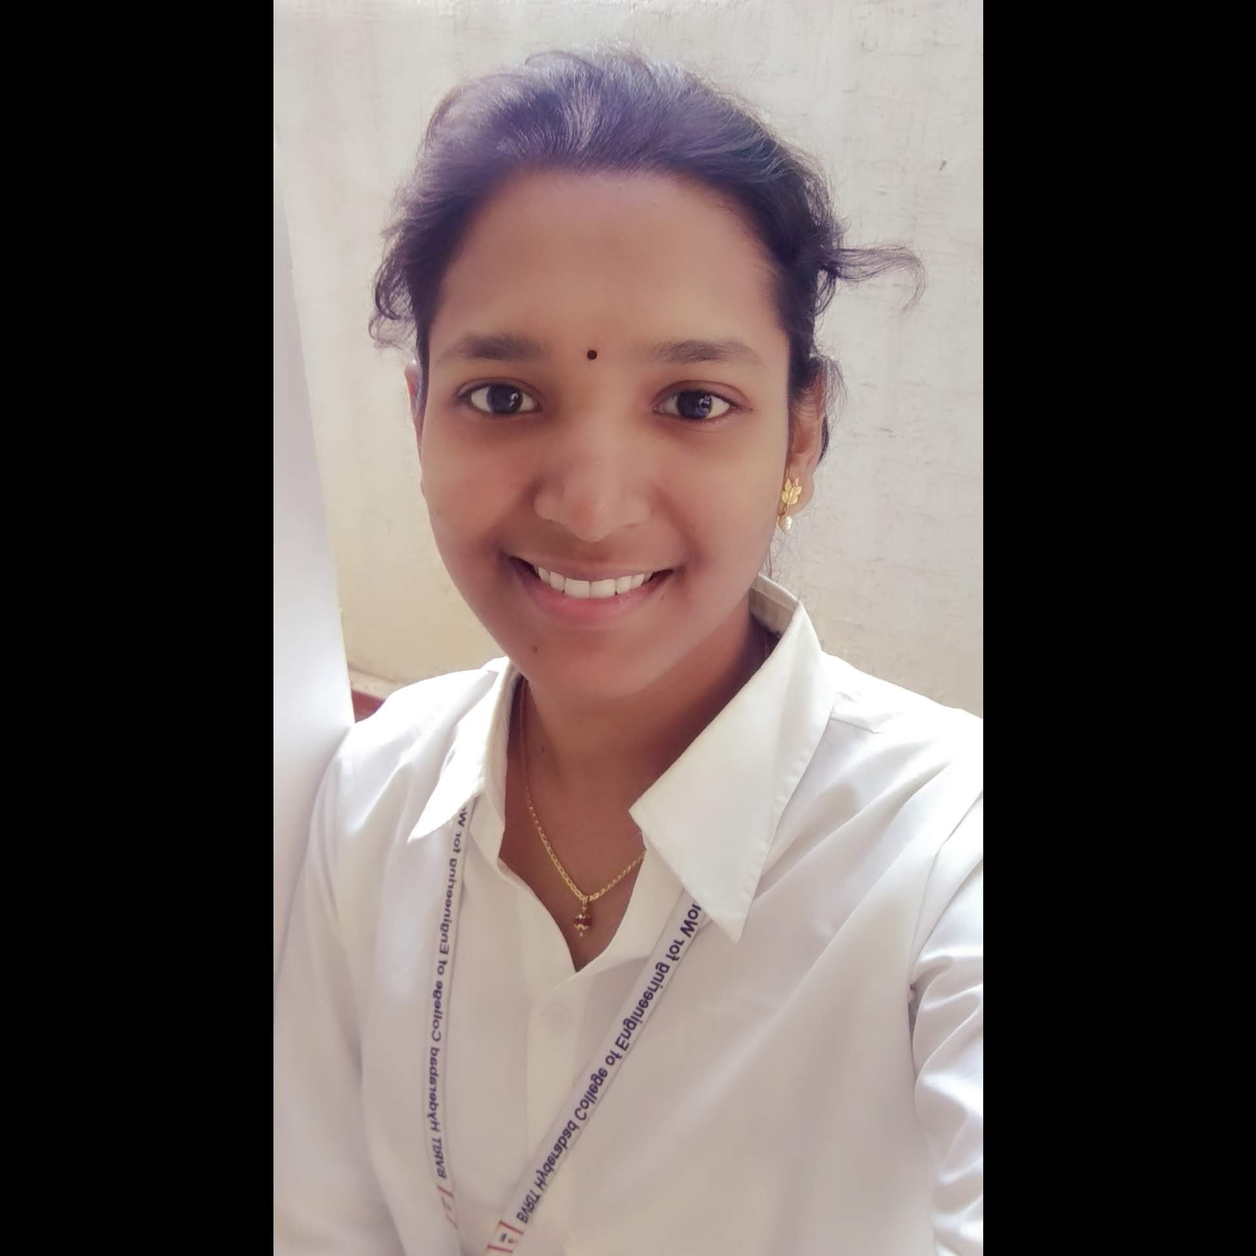
Atik
Agarwal
Ayushi
Agarwal
Isha
Kansal
Kaisar
Shabir
Latha
Sudabattula
Neelima Mukku
Vaishnavi
Ganji

Slide 11
TASK PERFORMED BY EACH GROUP MEMBER
Name | Responsibility
Atik Agarwal | Implemented Professor functionalities , Integration, Documentation
Ayushi Agarwal | Implemented User functionalities and Use Case Diagrams,Testing,Documentation
Isha Kansal
Kaisar Shabir | Implemented Admin functionalities Class Diagrams
Latha
Neelima Mukku | Implemented Student, User functionalities ,Testing
Vaishnavi Ganji | Implemented Student, User functionalities Sequence Diagrams

Slide 12

Project Goals
Notes:
Time – 3 mins

Slide 13




Problem Statement
To develop a POS application and REST API for Course Registration System using JAVA where the student can register, add/drop course, professors can view courses, enrolled students while admin can manage users, add/drop courses to catalog
1
2
Quality
Security
3
4
Interactivity
Speed
Notes:
User satisfaction and brand value
Problem Statement

Slide 14

Engineering Practices
Notes:
Time – 5 mins

Slide 15

ACTION PLAN-HOW WE PROCEED
Requirement Gathering
Tech Stack Selection
UML Artifacts, Architecture Design
Code development
Notes:
Implementation ->

Slide 16







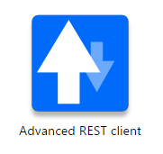











Designing
Backend
Testing
Data
SCM
UML
Core Language
Tools
SQL Database
Code Collaboration
Framework
Application Server
TECH STACK
Notes:
Time – 1 min
Java
Maven
DropWizard
MySQL
Jersey
GitHub
Postman / ARC (Check it)
StarUML / Dia / Lucid Charts
List
Design
Backend
Testing
Tools

Slide 17

Challenges & Learnings
Notes:
Time – 2 mins
Mac
Rest Setup
Null Pointer Exception and problem connecting to database

Slide 18
Challenges | Learning
Understanding the problem statement UML diagram conventions | UNIX Ubuntu Git commands UML Diagrams
Installation softwares on multiple environments POS application development using layered architecture | Java 8 Exception Handling SQL
Resolving jar and version dependencies Jersey validation Running Apache TomCat server Running our application with DropWizard | REST API development using Jersey and DropWizard Maven DropWizard

Slide 19

Architecture Design
Notes:
Time – 1 min

Slide 20

POS Application
Java Main Client
Business Code
Database Code
HTTP Request
HTTP Response
Notes:
n-tier

Slide 21
WEEK 1- UML DIAGRAM
ACTIVITY DIAGRAMS
ADMIN
PROFESSOR
STUDENT
CLASS DIAGRAMS
COURSE REGISTRATION
USER MANAGEMENT
3. SEQUENCE DIAGRAM
ADMIN
PROFESSOR
STUDENT
4. USE CASE DIAGRAM
USE CASE

Slide 22

FINAL DEMONSTRATION
POS
REST
DROPWIZARD
Notes:
Time –
Architecture – 5 mins
NFR Dashboard – 3 mins
Demo – 10 mins
1. Show the Responsiveness and Wave tool first

Slide 23

Questions
Notes:
Time - ?

Slide 24
Thank you
Notes:
Time – After this show the testimonial video. 1 min

